Slide 1
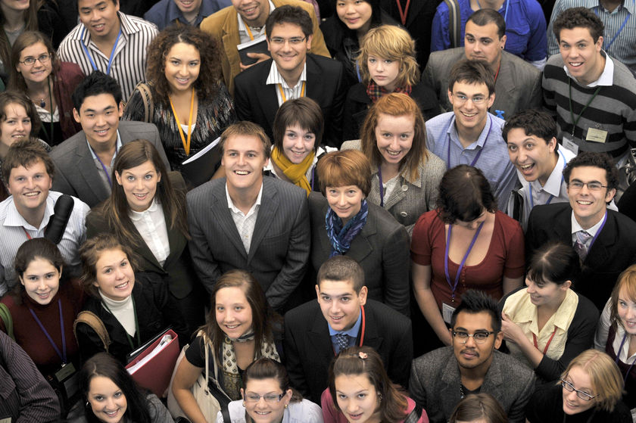
What does Generation Y want from your association?
Rob Davidson, University of Greenwich
UIA Associations Round Table, Singapore

Slide 2
Which generation are YOU ?
Four generations in the active population:
Traditionalists, born between 1925 and 1942 – mainly retired
Baby Boomers, born between 1943 and 1960 – beginning to retire
Generation X, born between 1961 and 1976
- managing
Generation Y, born between 1977 and 1995
- demanding

Slide 3
Since 2008
Generations X and Y have been able to out-vote Baby Boomers
Their values are replacing those of the previous generations, in the workplace and elsewhere

Slide 4
By 2025, approximately 75% of the world’s workforce will be Generation Y

Slide 5
Bye bye, Baby Boomers
“We are moving away from the values, attitudes and lifestyles of the once influential Baby Boomers (born 1943 to 1960) toward the values, attitudes and lifestyles of the younger generations”.
(Hira, 2007)

Slide 6
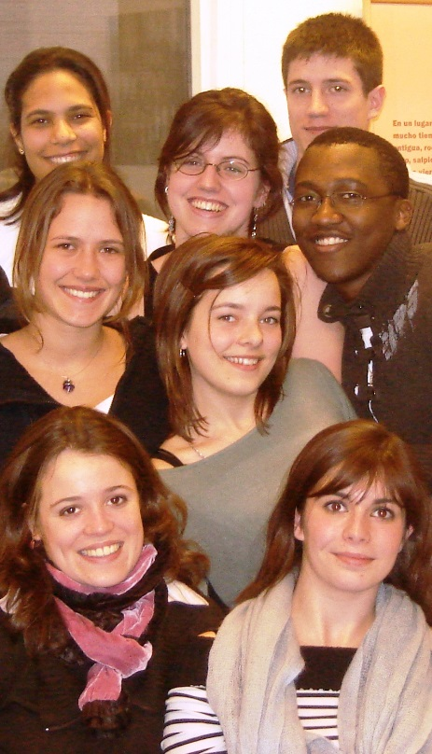
Generation Y Characteristics
Seeking work-life balance
Blurring the lines between
socialising and work
Global citizens
Socially and environmentally
Conscious. More tolerant
Life-long learners
Seek access to personal development

Slide 7
Generation Y Characteristics
Tech-savvy (or tech-dependent?)
Electronic devices are ‘extra limbs’
The web is a 2-way communication tool
Multi-tasking
Instant gratification
Shorter attention spans
Need constant feedback
Like a lot of options

Slide 8
Generation Y – Challenges for associations
Most associations are ageing in terms of membership
Many of your current members could be the parents of Gen Y
Gen Y are a hard sell. Fiercely individualistic: love groups, not teams
Gen Y is not long-term-commitment driven. Frequent job-changers

Slide 9
Generation Y – Challenges for associations
They have a sense of entitlement, which can make them high-maintenance customers
They need a different style of management:
“If you try to manage Gen-Y using an old, outdated, command-and-control style of leadership, this generation will walk out your door before lunch. And before the end of the day, they'll blog, IM, and text about their experience with you (warning their friends to stay away)”

Slide 10
Winning Gen-Y members
Communicating with them:
“Generation Y depends on visual learning. All their lives, they were raised on graphics, games, the Internet and online games. This is a generation whose marketing has been pictorial and graphic … to attract them, you need to be dynamic in your use of graphics and pictures”
Lynch, 2006. qu. Dr. Rach of New York University

Slide 11
Winning Gen-Y members
Use as few words and as many strong images as possible
Think in text-messaging format – short, very short, efficient messages
Communicate with them FREQUENTLY !

Slide 12
Winning Gen-Y members
The best resource for attracting Gen Y members is your current Gen Y members
Interview some young members about what they're getting out of their membership, personally and professionally
Gen Y values lifestyle and relationships above work, so sell your association as a whole new lifestyle for them

Slide 13
Winning Gen-Y members
ASK THEM what they want from you:
… educational courses that are of interest, have convenient time frames, at affordable prices; their chosen means of communication ?
Include it into your strategic plans, and actually DO it.

Slide 14
Using technology
They expect to get all the information they need about a topic online, so if your association doesn't have a solid presence on the Web, you need to build one
Create pages for on social networking sites like Facebook
Put video testimonials from current members on YouTube to explain why members of Generation Y should join

Slide 15
Using technology
But avoid jumping into the social media network unless you actually have something to offer – added value

Slide 16
Case-study: AALL and Gen Y
Chicago-based. Over 5000 members
Created a Gen X / Gen Y Caucus in 2005
Inspired by the ‘AALL Task Force on Generation X and Generation Y’

Slide 17
Case-study: AALL and Gen Y
Mission = To provide a forum for younger AALL members and those AALL members who are young at heart to connect with one another and foster an environment of lifetime learners within the profession
To be an important additional voice in the AALL organization, increase the knowledge and ability of our members, and to assist them in their continued growth toward a rewarding career

Slide 18
Case-study: AALL and Gen Y
Works through sub-groups:
Image, Newsletter, Program, Publications, Social …

Slide 22
Designing events that will attract Generation Y
They like to be asked for their opinions, suggestions
They love interactivity
They want involvement at the planning stage
Choice of destination
Choice of topics, speakers
Choice of social activities

Slide 23
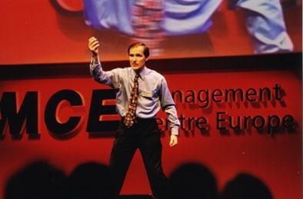
From speakers, they want -
SHORTER presentations
Infotainment / Edutainment
‘The adult learners of today expect "infotainment," the delivery of information in an entertaining format… There aren't many places that people go where they are not treated to a ‘show’ - and meetings are no exception’.
Ramsborg G and Tinnish S, How Adults Learn, Part 2, from Convene magazine (PCMA), February 2008.

Slide 24
From speakers, they want -
Information that can help them advance in their current jobs or become better prepared when they move on. Motivational speakers don’t motivate them.
Information they cannot get off the Internet or from a book.
Speakers who are in a position of power. They want to know how the ‘game’ is played.
PowerPoint to be used correctly:
(Ann Fishman www.annfishman.com)

Slide 25
Networking - more STRUCTURE required

Slide 26
Social legacy
The antidote to conspicuous consumption and elitism
Generates positive PR
Ethically sound

Slide 27
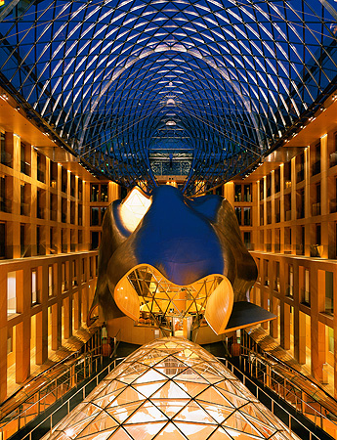
Conference venues for Generation Y
Chill-out zones
Natural daylight
Outdoor areas
Green !
Iconic design

Slide 28
THE CHALLENGES
The continuing success of your association depends upon achieving a firm understanding of what Generation Y really wants
Many of the traditional association services and conference programmes will not motivate this generation
But we must offer services that will satisfy the needs of ALL generations in the workforce – without alienating anyone.

Slide 29
THANK YOU, EVERYONE
R.Davidson@greenwich.ac.uk

