Slide 1
Ensuring Value for
Your Members
UIA Associations Round Table
Singapore, October 2013
Greta Kotler, CAE
Chief Global Development Officer
ASAE
Washington, DC, USA

Slide 2
What are the trends and issues that are facing associations?
How do you create value? How can you ensure that what your association is offering continues to be relevant?
What are successful ways to engage members?
Notes:
Trends
Value for Money
Relevance
Doing More with Less
Time

Slide 3
Trends Impacting Associations *
Demographic Shifts
Technology Advances
Networks Organize/ Enable
Sector Blurring
Volunteerism
*Adapted from Convergence: How five trends will reshape the social sector,
The James Irvine Foundation and La Piana Consulting, November 2009
Notes:
Multiple generations working side-by-side
Learn to share leadership across generations and cultures.
Technology: Associations have been quick to adopt social media
Now need to improve ability to effectively choose among the channels
No single organization-wide identity
Mobile is it
Mobile Impacts Multiple Aspects of Our Work
Web, tablet, and smart phone platforms
Advertising is different on each platform
Content distribution is different on each platform
Applying the new ways of networking to the traditional model.
Allows for deeper, more meaningful collaboration
Opens and encourages a global and diverse community of thought and practice.
Associations may no longer be “institutions.”
Less focused on the organization as a central unit
Find ways to have impact across networks and programs.
Forge new and/or collaborative partnerships.
More for-profit organizations see the value of “doing well by doing good”
More not-for-profit engaged in for profit activities
Challenge to associations is to thrive in a blended economy
Economic & time pressures make Virtual Volunteering and Micro Volunteering more attractive.
Challenged to align volunteer opportunities with an increasingly diverse pool of volunteers.
Engage in meaningful work.

Slide 4
When Five Trends Converge
Demographic shifts
Technology advances
OUCH!
Sector blurring
Networks for organizing
Volunteerism

Slide 5

Other Challenges Outlined From Your Feedback
Doing More with Less
Time to participate
Getting to know members at a deeper level
Getting their Attention: Communicating in an appropriate way
Keeping member’s interest in continuous engagement

Slide 6
How can you create value?
How can you ensure that what your association is offering continues to be relevant?

Slide 7

Notes:
We can start with a look at ASAE research findings from the Decision to Join (2008). A lot has changed in the environment, but these findings are still relevant.
We can start with a look at ASAE research findings from the Decision to Join (2008). A lot has changed in the environment, but these findings are still relevant.

Slide 8
Why Join?
 | Asia (744) | Europe (800) | Oceania (229) | All (16,944)
Providing timely information about the field | 49.3 | 46.1 | 42.8 | 36.9
Connecting practitioners | 38.4 | 44.9 | 36.2 | 36.7
Representing the field to the public | 28.4 | 39.3 | 27.1 | 27.1
Representing the field to the government | 16.3 | 27.9 | 29.3 | 27.0
Notes:
IN Europe notice the importance of connecting practitioners.

Slide 9

How Do You Create Value?
Define value:
  Members decide what has value
  Value is validated by a member’s willingness to exchange money or time for something
  Value changes
  From Road to Relevance: 5 Strategies for Competitive Associations,
  by Harrison Coerver and Mary Byers, CAE, Published by ASAE (2013)
Notes:
From: Road to Relevance: 5 Strategies for Competitive Associations, by Harrison Coerver and Mary Byers, CAE Published by ASAE (2013)

Slide 10
Membership Value
The number one reason members join an association is because they believe that association will help them solve a problem
The End of Membership as We Know It: Building the Fortune-Flipping, Must-Have Association of the Next Century by Sarah L. Sladek, Published by ASAE (2011)
Notes:
Right now, the number one problem most people are facing is likely related to their finances. They economy has forced people out of jobs, cut into their savings, and jeopardized their futures.” (pg. 39)
Don’t nickel-and-dime; members want more from their membership

Slide 11

Walk in Your Member’s Shoes
What are your member’s objectives?
What are they trying to accomplish?
What problems are they trying to solve?
What trends are impacting their businesses and organizations?
What can you provide that they can’t provide themselves?

Slide 12

Learn More About Your Members
Listen
At Meetings
Create a platform for informal idea-sharing sessions to swap tips related to your members’ profession or area of interest.
Visit their offices/place of work; countries
Stay in contact.
Research
Satisfaction surveys
Program evaluations
Focus groups
Interviews

Slide 13
Creating Value: What Can You Provide to Your Members that They Can’t Provide Themselves?

Slide 14

Be Their Trusted Source of Content
Build Their Trust
Be a curator of content
Help them through the Clutter
Give them the vetted solutions – and best practices
Notes:
ASAE example of our Resource Center where we used to send out several pages of resources
What they want it the best solution; the vetted solution
They want us to go through the clutter and provide the best information or tool for their problem
That can sometimes be a real

Slide 15

Provide Unique Knowledge
  Research
  Trade, Professional societies and Federations can provide research on the industry or profession that companies, individuals, or organizations cannot provide themselves
  Economic Trends
  Associations are ideally positioned to study economic trends and impact
Trade Associations may even have a Chief Economist to serve the industry.

Slide 16

Provide Essential Learning
Learning
Your response: 86% said that your members engage in workshops and seminars
Determine what skills and knowledge they need to solve their problem
Create a learning experience that will stand out from the rest
  Define the experience so that you can repeat & teach it

Slide 17
Provide a Unified Voice
Advocacy and Lobbying give an industry or profession a united voice with government officials
Advocacy
  represents the interests of the industry or profession
  results in standards and improvements for the industry or profession
  enhances the image of the industry or profession

Slide 18

Create Career Value
Career Development is particularly important to younger members
Show them pathways to their goals
Offer Certification and
opportunities to enhance their resumes

Slide 19


Communicate The Value
How will you communicate value to them?
  Don’t assume they know or recognize what you offer
  Communicate often and clearly using multiple channels
  Remind them of value BEFORE renewal
  Seek out testimonials & share
  Help People Navigate your sources
  Get peers to persuade peers

Slide 20

At Your Tables
Provide exceptional value to your members:
What is one thing you do now that you believe provides exceptional value?
What is one thing that you could do in the future to enhance that value?

Slide 21
Build Value Through Engagement:
What are ways to Engage Members that will keep them coming back?

Slide 22

What is Member Engagement?
“…capturing the attention, affiliation, and loyalty of members by giving them what they need through highly relevant value-building activities.”
199 Ideas: Member Service and Engagement, published by ASAE (2011)
Notes:
From: 199 Ideas: Member Service and Engagement, published by ASAE (2011)
Involved members don’t drop out.
Meaningful connections and experiences for your members will keep them coming back.
It costs five to six times more to recruit a new member than it does to keep an existing one.
Focus on first-timers’ experience with you.

Slide 23


Forms of Engagement
Welcoming new members
Through Benefits and Services
Through Relationships/Community
199 Ideas: Member Service and Engagement, published by ASAE (2011)
Notes:
From: 199 Ideas: Member Service and Engagement, published by ASAE (2011)
Link them up with like individuals and organizations from which they will derive value
Recognize new members.
Encourage new members to join a component, special interest group, or community of practice.
Engage new members using high-touch techniques.

Slide 24

Engagement through
Benefits and Services
Offer exclusive members-only events.
Create offers that capture their imagination and exceed their expectations.
  Free Downloads
  Case studies
  Executive Summaries
Notes:
From: 199 Ideas: Member Service and Engagement, published by ASAE (2011)

Slide 25

Engage Through Technology

Slide 26
Use Technology To Engage Members
Technology is something to embrace as yet another way to deliver value and customer service.
  The End of Membership as We Know It: Building the Fortune-Flipping, Must-Have Association of the Next Century by Sarah L. Sladek, Published by ASAE (2011)

Slide 27
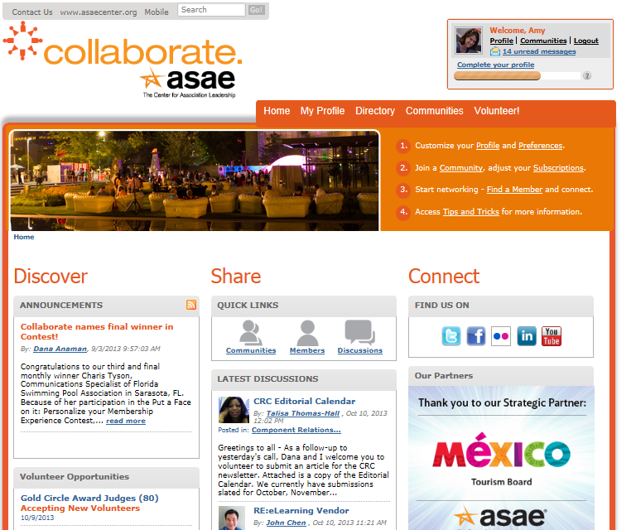
Collaborate Site

Slide 28

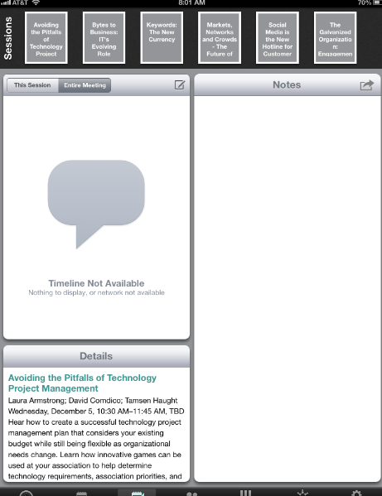
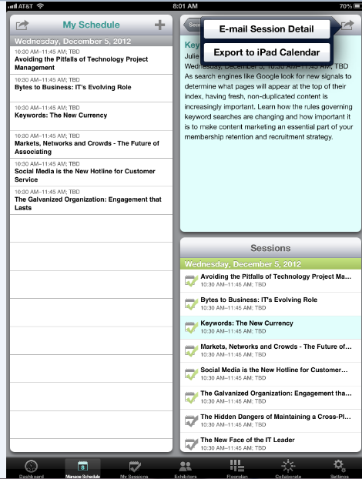
Conference Mobile App

Slide 29


Associations Now

Slide 30

Engage Through Volunteering

Slide 31
Patterns of Volunteering
  The Decision to Volunteer, ASAE, 2009
Notes:
Governance 6.8%
Committee 7.8%
Ad hoc 15.5%
None 69.9%

Slide 32
Typical Levels of Involvement
Governance 6.8%
Committee 7.8%
Ad hoc 15.5%
None
69.9%
Notes:
Let’s start with a little benchmarking. This slide shows the average extent and types of volunteering across the 18 co-sponsoring organizations in our Decision to Join study. In addition to giving a benchmark, it also raises some interesting philosophical questions … namely, is it a good thing or a bad thing to have 70% of your members paying dues but not fulfilling ANY type of volunteer role?
Governance 6.8%
Committee 7.8%
Ad hoc
15.5%
None
69.9%
FINDINGS:
Probability of being a “promoter” of the association increases with level of involvement

Slide 33
Increase Volunteering
I would start volunteering if:
  Meaningful opportunity
  Right skills
  Accessible location
I first learn about volunteer opportunities by:
  Asked by staff or another volunteer (22%)
  Local chapter, section (14%)
  Meeting, conference (13%)
  The Decision to Volunteer, ASAE, 2009
Notes:
Uncontrollable reasons:
Time constraints
Family or professional responsibilities
Life stages
Controllable reasons:
Lack of info about volunteer opportunities.
Volunteer elsewhere.
Never asked to volunteer.
Lack of info about virtual or short-term opportunities.
Highlight or profile members and volunteers who have made considerable contributions and/or achievements.
Say “Thank You” to your volunteers.
Make it easy to get involved.

Slide 34
At Your Tables
Engaging your members:
What are some good examples that have worked well for you?
What is one thing that you could do in the future to engage your members (that you don’t do today?)

Slide 35




In conclusion …
Notes:
If you’re looking for a cheat sheet for building a membership dominance, the advice in this book comes down to six key points:
Understand what your members want and need.
Develop member benefits that solve the problems of your target audience.
Assess the costs to provide those benefits and get rid of anything that doesn’t provide a benefit.
Put a membership model in place that both aligns with the way your audience wants to pay to have their problems solved and makes it easy for your offering to sell.
Test these offerings and revenue models with members and nonmembers. Make adjustments accordingly.
Repeat.
If you’re looking for one piece of light-a-fire-under-my-CEO information it’s this: Change or die. There are no alternatives.

Slide 36
Thank you!
Let ASAE help you succeed.
www.asaecenter.org
www.associationsnow.com
(Subscribe to FREE daily e-Newsletter)
Greta Kotler, CAE
gkotler@asaecenter.org
+1.202.326.9506

