Slide 1
challenge of transitioning Association __________ ad-hoc to a dedicated secretariat
Author
Hemant K Batra
Vice President, Saarclaw
Founder, Kaden Boriss

Slide 2
An organization, no matter how well designed, is only as good as the people who live and work in it. Dee Hock

Slide 3
SAARCLAW (South Asian Association For Regional Co-operation In Law)
1991: Regional Apex Body of Legal Communities of 8 Nations
Objectives: People 2 People Cooperation & Socio-Economic Development

Slide 4
Challenge As to structure
Ad-hoc is another name of honorary
Finding the selfless passionate soldiers is an uphill task
Office-bearers with tags & positions are like dead wood
Office-bearers with resources are diseased with arrogance
Lack of coordination & sync between parent & domestic chapters

Slide 6
Light Beer

Slide 7
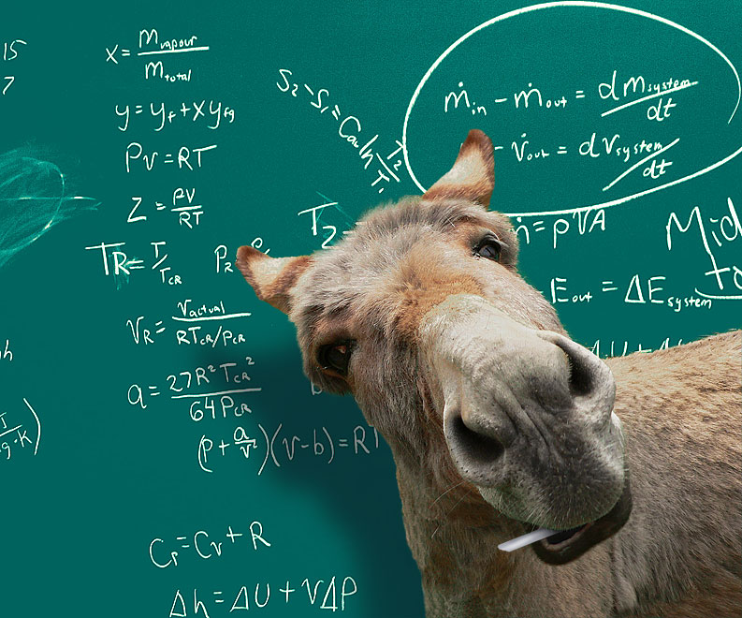

Slide 8
Smart Ass

Slide 9
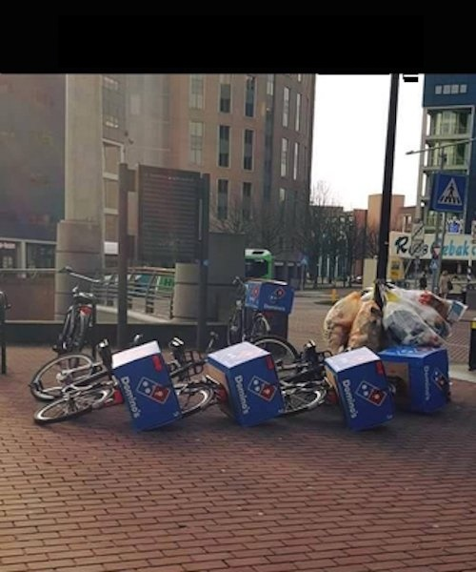

Slide 10
Dominos effect

Slide 11
Challenge As to communication
Ad-hoc system does not have any communication protocol
Lack of confidentiality as communication handled by shared staff
Miser approach as communication expenses non-reimbursable

Slide 12
Challenge As to Funding
Principal sources of funding limited & erratic
No fiscal accountability or audit
Sponsorships from corporations have the risk of dubiousness
Under financing is worse than no financing
No coercive system of recovery of dues

Slide 13
Path to Funding of A dedicated or permanent secretariat
Branding - IPR
Identify interested financial or development or global institutions
Background paper on size & composition of permanent secretariat
Adopt quid pro quo formulae with them
Adopt & execute the agenda of funding institution
Funding kinds – consulting projects, research projects, workshops, events, conferences

Slide 14
Path to establishing dedicated or permanent secretariat
Identify seat of secretariat – essence of logistical viability
Recruitment process – contractual manpower – whole-time director
Introducing fiscal transparency
Introducing democratic & efficient decision making – professionalism
Transition & transmission of controls & power

Slide 15
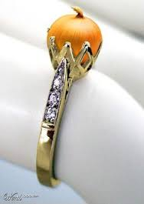

Slide 16
Onion ring

Slide 18
Taking control

Slide 20
Sleeping Pill

Slide 22
Key to happiness

Slide 23
Questions & Queries Are Welcome
Thank You
hbatra@saarclaw.org
hkb@kadenboriss.com

